Slide 1


JavaScript Set Collection
Welcome for this week presentation
Name: Igiraneza Rukamba Adal
What is set
Why can you use set
Compare Set to Array

Slide 2

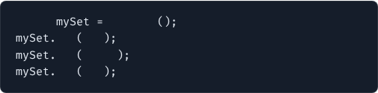
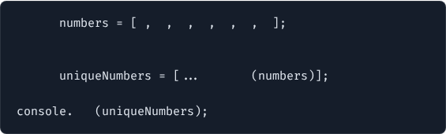
What is an ES6 Set?
Key Characteristics
A Set is a built-in object that stores collections of unique values of any type, whether primitive values or object references.
Set vs Array
const
new
Set
add
100
Unlike Arrays, Sets forbid duplicate values and do not use numeric indexing. They maintain insertion order and provide high-performance operations.
add
'ES6'
add
100
// Duplicate ignored!
•
Uniqueness: Automatic deduplication.
•
Keyless: Accessed by value rather than index.
const
1
2
2
3
4
4
5
// One-liner array deduplication
const
new
Set
log
// [1, 2, 3, 4, 5]

Slide 3

Set vs Array Performance
Operation | Set Method | Array Equivalent
Check Existence | set.has(val) | arr.includes(val)
Insert Element | set.add(val) | arr.push(val)
Remove Element | set.delete(val) | arr.splice(index, 1)
Enforce Uniqueness | Automatic | Manual indexOf checks

Slide 4
Iterating Over Sets
for...of Loops: Iterates directly through elements in insertion order.
forEach Method: Supports array-like callback invocation set.forEach(value => ...).
Spread Operator: Easily convert back to an array using [...mySet] for array manipulation methods.

Slide 5
Questions & Answers
Thank you for exploring ES6 Set in JavaScript!

